Slide 1
Introduction to Internet browsing
Course Code: CSC 1101
Course Title: Introduction to Computer Studies
Dept. of Computer Science
Faculty of Science and Technology
Lecturer No: | 09 | Week No: | 09 | Semester:
Lecturer: | Name & email

Slide 2
Lecture Outline
List of topics-
Safe internet browsing
IT Essentials Chapter 11 and 12
Discussion about different Learning Systems

Slide 3
Specific Objectives
Safe web browsing – privacy & Security
Safe web browsing habits
Google safe browsing –turn on google safe browsing
Creating email account using internet
Exploring different learning techniques

Slide 4
Safe web browsing
Privacy
The browser downloads and stores a record of the webpages that one visits on his/her computer or device.
This is called a web history, also known as a browser cache.
There are times when someone may wants to hide his/her activity online for safety reasons. There are a few ways to accomplish this:
1. Use private browsing:
Most browsers have a privacy mode that allows to visit websites without storing any record of activity on the computer or device. Different browsers have different private mode:
- Google: Incognito Mode
- Firefox: Private Browsing
- Internet Explorer: InPrivate Browsing
- Safari: Private Browsing

Slide 5
Safe web browsing
Privacy (cont..)
2. Clear cache, history, and cookies:
If you visited a site without privacy mode, you can erase records of your activity by clearing your cache, history, and cookies on your computer or device.
Different browser has the delete option for clearing the records:
Mozilla Firefox: delete browsing history, clear cache, and delete cookies
Internet Explorer: delete browsing history and delete cookies
Google Chrome: delete browsing history, clear cache, and delete cookies
Safari: privacy support

Slide 6
Safe web browsing
Security
Use secure sites:
Verify that a site is secure by looking for “https” at the beginning of the URL
The small lock icon that appears in the web address bar also verifies security.
These symbols let you know that the site has been encrypted, meaning that your visit to this site hasn’t been intercepted by another computer.
If you don’t see either security symbol, be cautious about information you share on that site. Some sites use “http,” which is not secure.
Encrypt your data:
Even if a site uses https, the hosts of that site can often still access your data.
You can choose to use services that encrypt your data before sending it to the cloud.

Slide 7
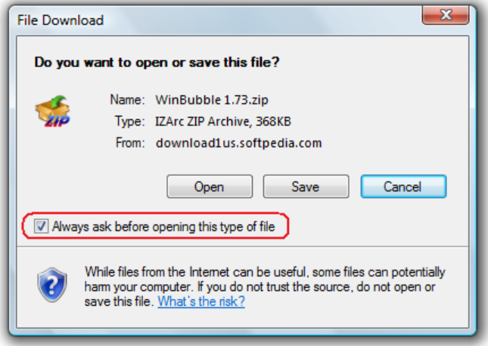
Safe web browsing
Keeping your browser updated:
New malware and phishing threats are constantly being introduced, so it is important to keep your browser updated.
Make sure you have the latest version of your browser.
Make sure you have installed all recent updates.
Save downloads vs. running them:
When a file download box pops-up, save the file to your system instead of directly opening it from the internet. This helps prevent erroneously running an internet virus.

Slide 8
Safe browsing Habits
Use an anti-virus software
Update anti-virus and anti-malware programs.
Always update Windows. These updates contain security updates
Be cautious when viewing popups. Some popups contain viruses which can be triggered at the press of a button.
When surfing the internet avoid websites that contain illegal software downloads, sexual references, free screensavers, etc. If you go near these sites you are immediately asking for trouble.
Never respond to Spam e-mails.

Slide 9
Safe browsing Habits (cont..)
Avoid using your e-mail address for random registrations.
Make your passwords difficult to figure out, by using a combination of letters, numbers, and special characters, and most importantly, change them regularly
Avoid using peer-to-peer (P2P) network programs. Bittorrent, Limewire, Bearshare etc are programs through which viruses can spread easily.
Use a firewall.
Bookmark important site

Slide 10
Google Safe Browsing
Google safe browsing is a blacklist service provided by Google that provides lists of URLS for web resources that contain malware or phishing content.
The Google Chrome, Safari, Firefox, Vivaldi, and GNOME Web browsers use the lists from the Google Safe Browsing service for checking pages against potential threats.
According to Google, as of September 2017, over 3 billion Internet devices are protected by this service.
Turn on Google safe browsing?
To ensure you have Safe Browsing Mode enabled,
open Chrome and head to Settings > Privacy.
Chrome's Safe Browsing mode can be toggled on or off in the settings.
From here you can enable or disable Safe Browsing, along with a number of other features.

Slide 11
Create Email account using internet
A brief demonstration will be shown on how to create an email account step by step in the class.

Slide 12
IT Essentials
Chapter 11,12
The module is available on CISCO account.

Slide 13
Discussion about different Learning Systems

Slide 14
Learning
Learning is the process of acquiring new or modifying existing
Knowledge
Behaviors
Skills
Values or
Preferences
Human learning begins before birth and continues until death as a consequence of ongoing interactions between person and environment.

Slide 15
Learning System
The nature and processes involved in learning are studied in many fields, including
Educational psychology
Neuropsychology
Experimental psychology and
Pedagogy
Learning may occur as a result of habituation, classical conditioning, operant conditioning or more complex activities such as play.

Slide 16
Learning Techniques
Non-associative learning
- A relatively permanent change in the strength of response to a single stimulus due to repeated exposure to that stimulus. It is divided into 2 types.
Habituation: The strength or probability of a response diminishes when the stimulus is repeated.
Sensitization: the progressive amplification of a response follows repeated administrations of a stimulus.
Active Learning
- Active learning occurs when a person takes control of his/her learning experience.
Notes:
Non Associative learning is a relatively permanent change in the strength of response to a single stimulus due to repeated exposure to that stimulus.

Slide 17
Learning Techniques
Associative learning
Associative learning is the process by which a person learns an association between two stimuli.
Operant conditioning
Classical conditioning
Observational learning
Imprinting
Notes:
Operant conditioning: a reinforcement (by reward) or instead a punishment given after a given behavior, change the frequency and/or form of that behavior.
Classical conditioning: Classical conditioning involves repeatedly pairing an unconditioned stimulus (which unfailingly evokes a reflexive response) with another previously neutral stimulus.
Observational learning: Observational learning is learning that occurs through observing the behavior of others.
Imprinting: Imprinting is a kind of learning occurring at a particular life stage that is rapid and apparently independent of the consequences of behavior.

Slide 18
Learning Techniques
Play
- Play generally describes behavior with no particular end in itself, but that improves performance in similar future situations.
Enculturation
-Enculturation is the process by which people learn values and behaviors that are appropriate or necessary in their surrounding culture.
Episodic Learning
Episodic learning is a change in behavior that occurs as a result of an event.

Slide 19
Learning Techniques
Multimedia Learning
- Multimedia learning is where a person uses both auditory and visual stimuli to learn information.
E-learning and augmented learning
- Electronic learning or e-learning is computer-enhanced learning. When a learner interacts with the e-learning environment, it's called augmented learning.
Meaningful Learning
- Meaningful learning is the concept that learned knowledge (e.g. a fact) is fully understood to the extent that it relates to other knowledge.

Slide 20
Learning Techniques
Informal Learning
- Informal learning occurs through the experience of day-to-day situations. It is learning from life, during a meal at table with parents, play, exploring, etc.
Formal learning
- Formal learning is learning that takes place within a teacher-student relationship, such as in a school system.
Incidental Learning
- In incidental teaching learning is not planned by the instructor or the student, it occurs as a byproduct of another activity — an experience, observation, self-reflection, interaction, unique event, or common routine task.

Slide 21
Factors affecting learning
Status of student
Physical environment
Goals or purposes
Motivational behavior
Interest
Attention
Aptitude and attitude
Emotional conditions
Learning activities

Slide 22
Proficient Learner
Being a good learner is a skill
It is not just about sitting in front of your book and reading and hoping something will ‘stick’, or about completing yet another problem sheet or exam.
In order to become interested and proficient in the topic you are studying, you will need to go a bit deeper and your ability to do this makes you a skilled and lifelong learner, a learner that not only knows ‘what’, but also ‘how’ and ‘why’.
Knowing ‘how’ and ‘why’ is increasingly important as knowledge has a shelf life, like so many other things.

Slide 23
Proficient Learner
Your degree of motivation for your subject will determine how you study and how much effort you put in.
If you are not very motivated you will more than likely be someone who will memorize enough facts to get you through the coursework and exams; you will be what is called a ‘surface learner’
In order to be a Proficient Learner; you need to:
be responsible for your own learning
know yourself as a learner
reflect on your learning.

Slide 24
“Live as if you were to die tomorrow.
Learn as if you were to live forever.”
-Mahatma Gandhi

Slide 25

Questions??
https://safebrowsing.google.com/

Slide 26
References (for further study)
https://www.ltnow.com/7-tips-for-safe-web-browsing/
https://www.bluelinkit.com/safe-browsing-habits/

Slide 27
References
https://www.ltnow.com/7-tips-for-safe-web-browsing/
https://www.bluelinkit.com/safe-browsing-habits/
https://www.rainn.org/articles/safe-web-browsing
https://safebrowsing.google.com/

